Slide 1
Recommender systems

Slide 2
Recommender system
Use cases
Data and Evaluation
ML Algorithms
Online serving

Slide 3
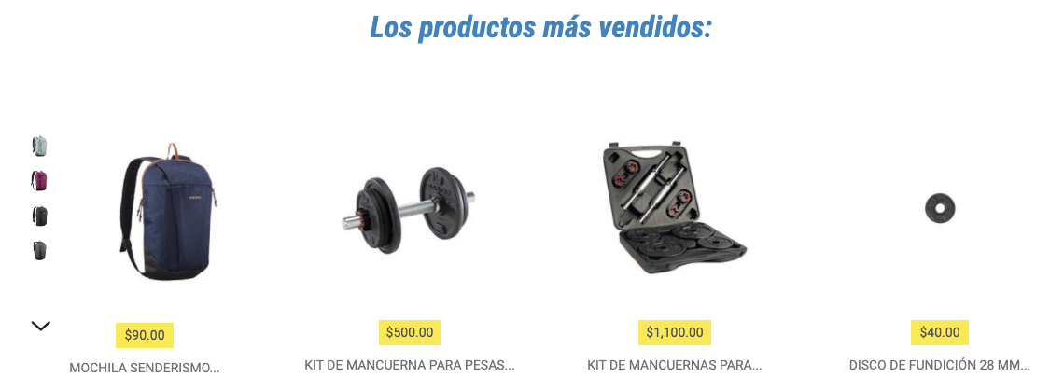

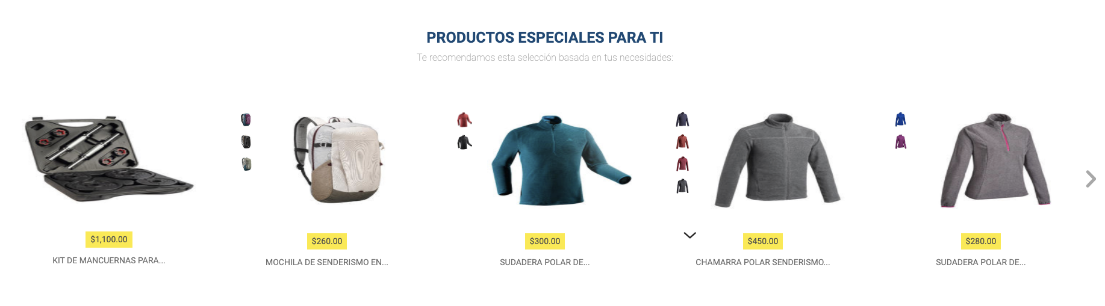
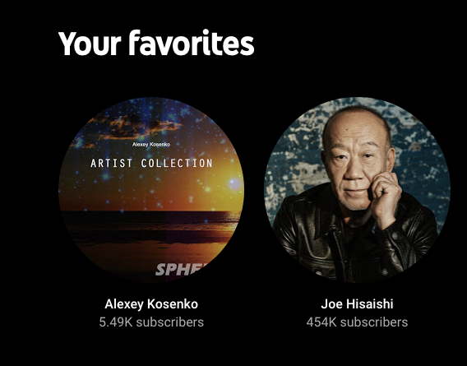
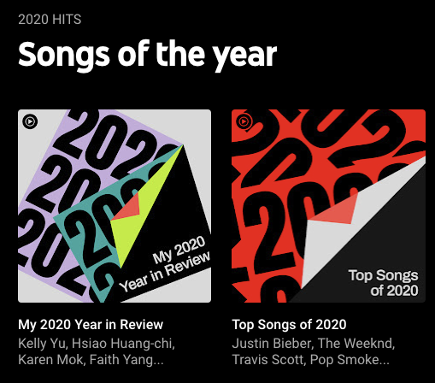



Slide 4
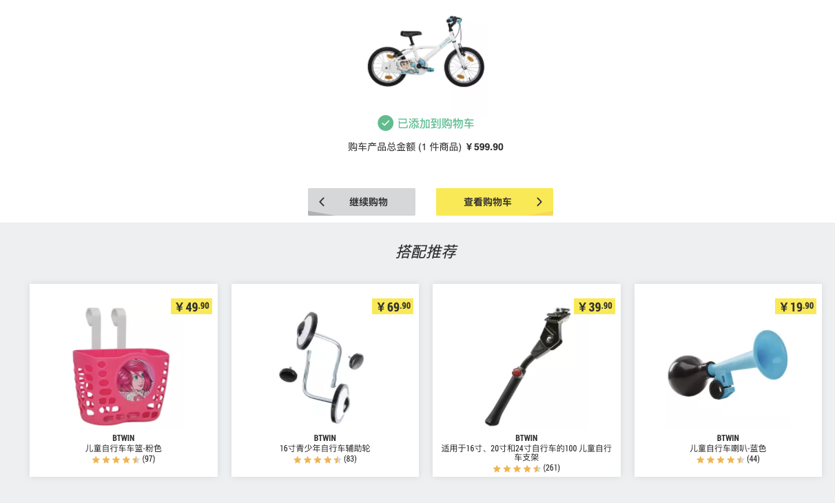


Slide 5
Use cases
Item2items
Items2items
User2item
User2user2item
User2item2item
Rule based
Cross selling
Basket completion
Personalized homepage
Personalized email - post purchase
Personalized email - search / click / reminder
Product bundles

Slide 6
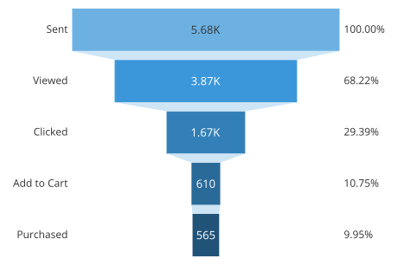
Understand the data
User behavior funnel
Product features
Structured data:
Family
Product nature
Department
Universal
Sport
Sport group
Non structured data:
Descriptions, labels, images
Recall about product levels:
Super model code (DSM)
Model code (MDL)
Stock-keeping unit (SKU)

Slide 7
Recommender system vs. Advertising
Advertising aims at optimizing the profits of the advertiser, the publisher and the third parties based on your browsing history.
Data are bought from data management platform (DMP), like Oracle or Salesforce
Recommender systems are machine learning systems that help users discover new product and services, based on their history purchase or click history and profiling.
Search ranking

Slide 8
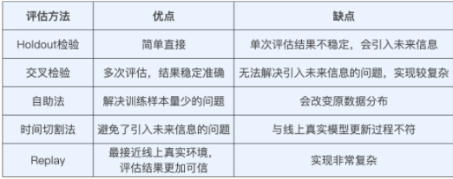
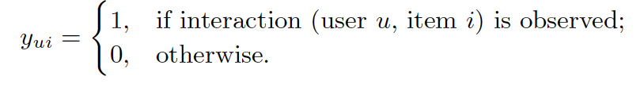
Evaluation
Offline / online evaluation
Data split. How?
Negative sampling
Explicit feedback (i.e., ratings and reviews)
Implicit feedback
Embedding-based Retrieval in Facebook Search
Concept drifting

Slide 9
Our practice
Precision - recall - coverage
Baseline for offline evaluation?
Jaccard coefficient: product or user similarity
Mean average precision
Normalized Discounted Cumulative Gain
Precision@k = (# of recommended items @k that are relevant) / (# of recommended items @k)
Recall@k = (# of recommended items @k that are relevant) / (total # of relevant items)

Slide 10
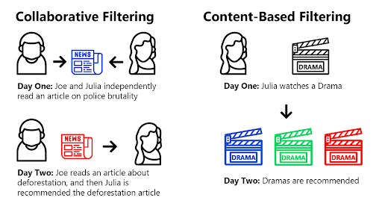
ML Algorithms
Popularity based - rule based
Content-Based Filtering (CBF)
Collaborative Filtering (CF)
Matrix factorization: Alternative least square
Mixed content collaborative filtering
Ranking based: Product embedding + cosine distance

Slide 11
Fine ranking
Feature engineering: LR, Tree
Learning to rank: pointwise, pairwise, listwise: LambdaMart
ANN:
DIN

Slide 12
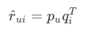
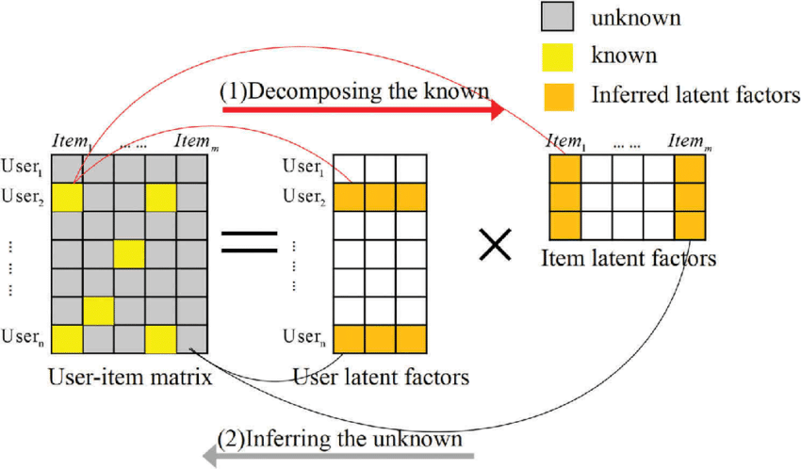
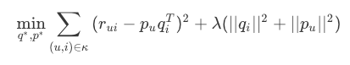
Matrix factorization (Netflix Prize)
decomposing the user-item interaction matrix into the product of two lower dimensionality rectangular matrices: latent features of users and items.
SVD
Loss function of SVD
Gradient descent
Alternating Least Squares (ALS)

Slide 13
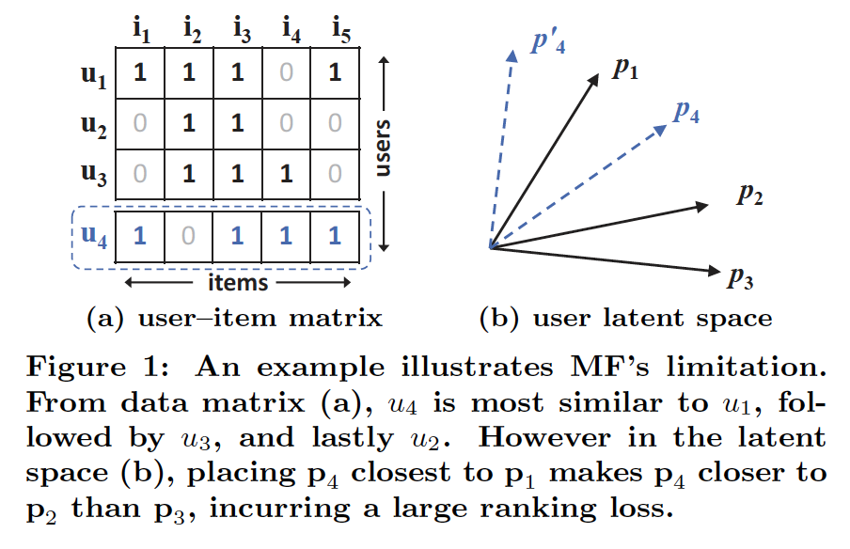
Neural CF
Learning from Implicit Data
Matrix Factorization limitation
Generalized Matrix Factorization (GMF)
Multi-Layer Perceptron (MLP)
Two models:
Neural CF
Neural matrix factorization

Slide 14
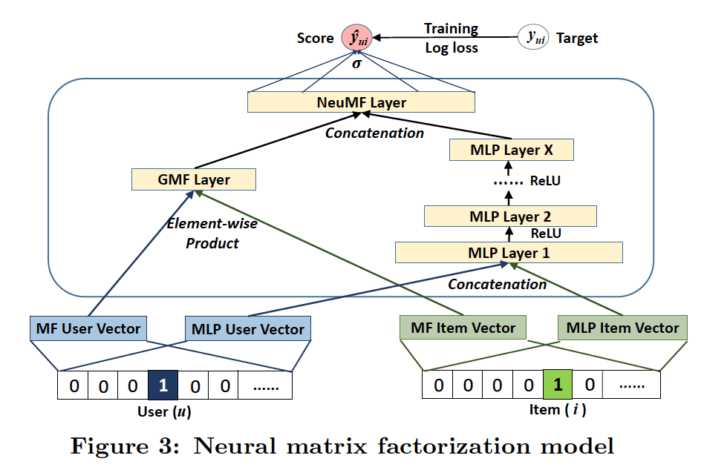
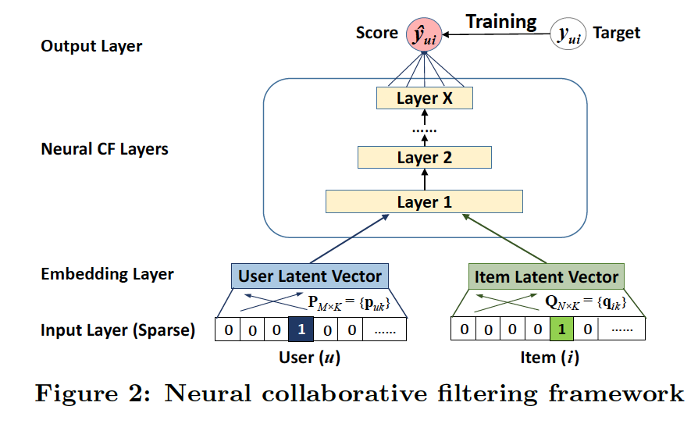

Slide 15
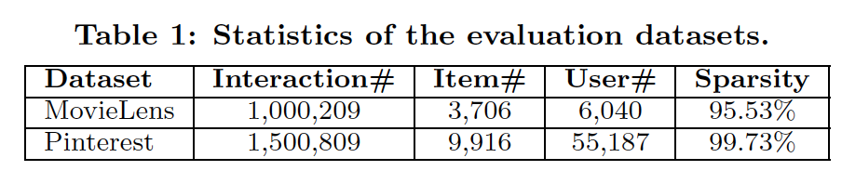
Evaluation
Hit Ratio (HR) : intuitively measures whether the test item is present on the top-10 list
Normalized Discounted Cumulative Gain (NDCG) : accounts for the position of the hit by assigning higher scores to hits at top ranks
Without special mention, we truncated the ranked list at 10 for both metrics

Slide 16
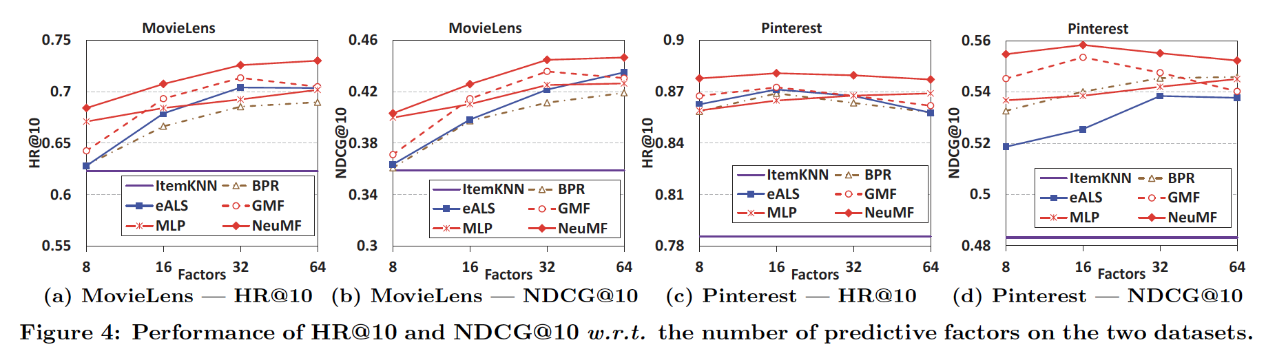

Slide 17
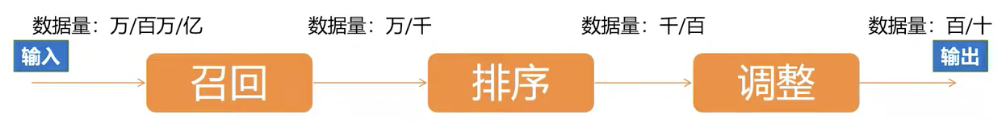
Online service : 99% < 250 ms response
Offline
Offline LSH 局部敏感哈希: put users into buckets
faiss

Slide 18
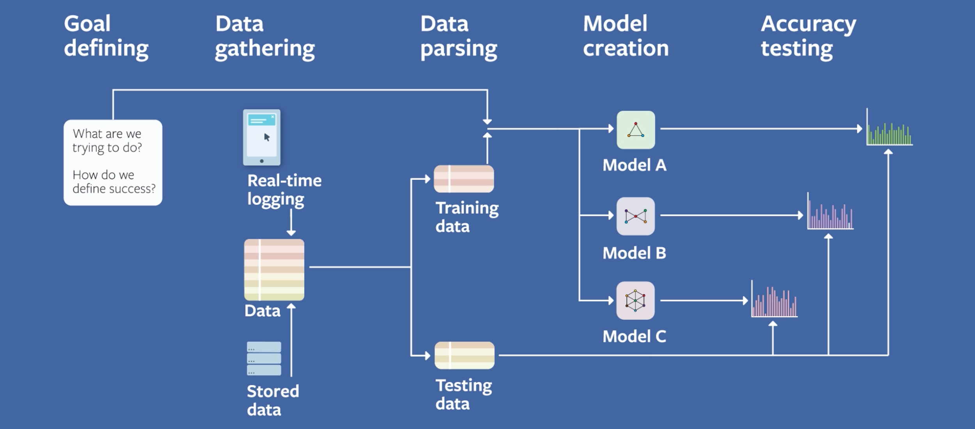
ML sys design
Infra:
Facebook (faiss)
Youtube
Netflix
Graph neural networks:
Pinterest
Uber eats
airbnb
https://research.fb.com/the-facebook-field-guide-to-machine-learning-video-series/?ref=hackernoon.com

Slide 19
Other issues
Cold start
Seasonality
Model bias: more popular - more recommendation - more popular
Long tail data
Potential interest：Deep Interest Evolution Network for Click-Through Rate Prediction

Slide 20
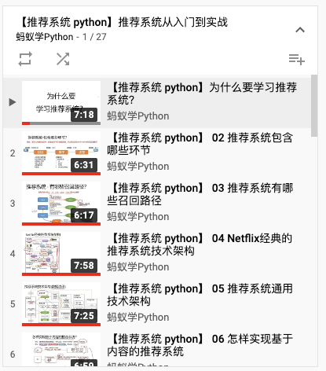


Video resources
https://www.youtube.com/watch?v=jNe1X6L1DyY&list=PLCemT-oocgalODXpQ-EP_IfrrD-A--40h
https://time.geekbang.org/

Slide 21
Papers to read
Predictive model performance: offline and online evaluations
Factorization machines
A few useful things to know about machine learning
Deep neural networks for Youtube recommendations
Wide & Deep learning for recommender systems
Practical lessons from predicting clicks on ads at Facebook
Wide & Deep Learning for Recommender Systems
Billion-scale Commodity Embedding for E-commerce Recommendation in Alibaba
Deep Interest Evolution Network for Click-Through Rate Prediction

Slide 22
Deep Neural Networks for YouTube Recommendations
Large scale recommendation
Freshness: new video
User history: Sparse data
No user rating
No ontology - unstructured data associated to video
Context in 2016: In contrast to vast amount of research in matrix factorization methods, there is relatively little work using deep neural networks for recommendation systems.
No transformer

Slide 23
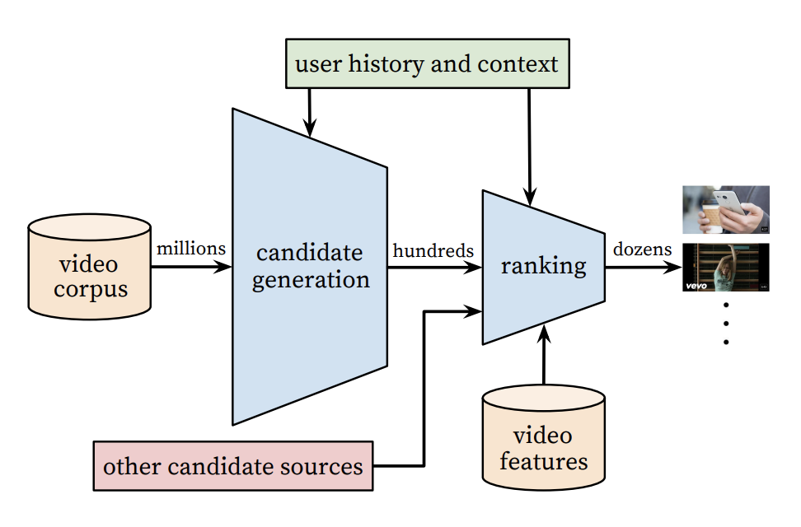
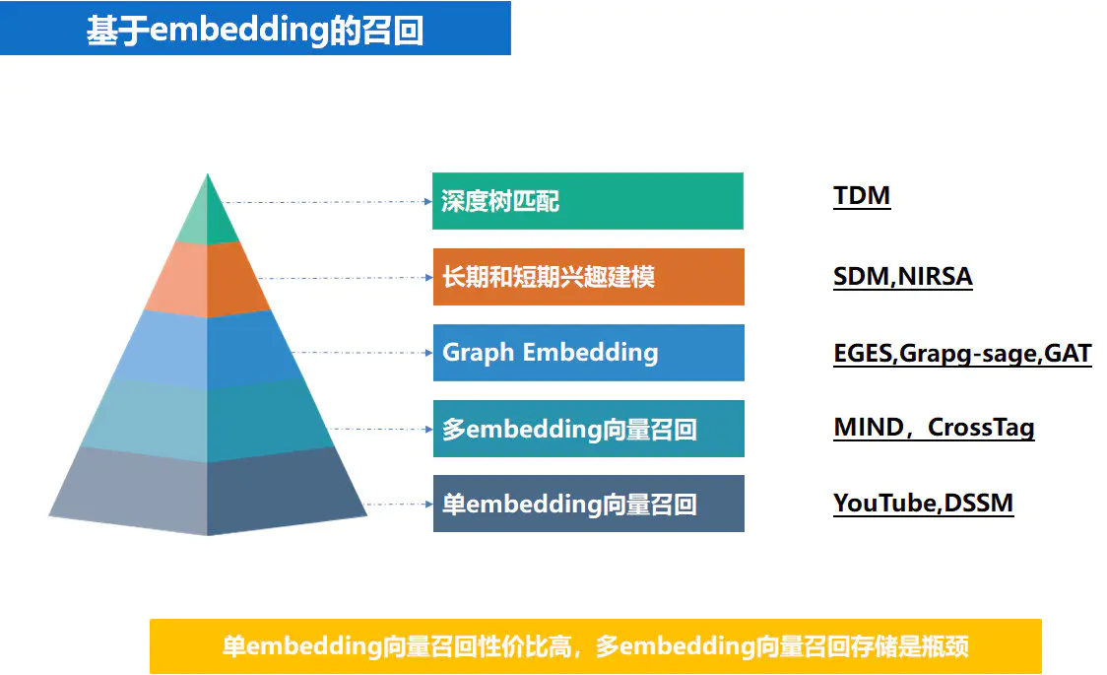

Slide 24
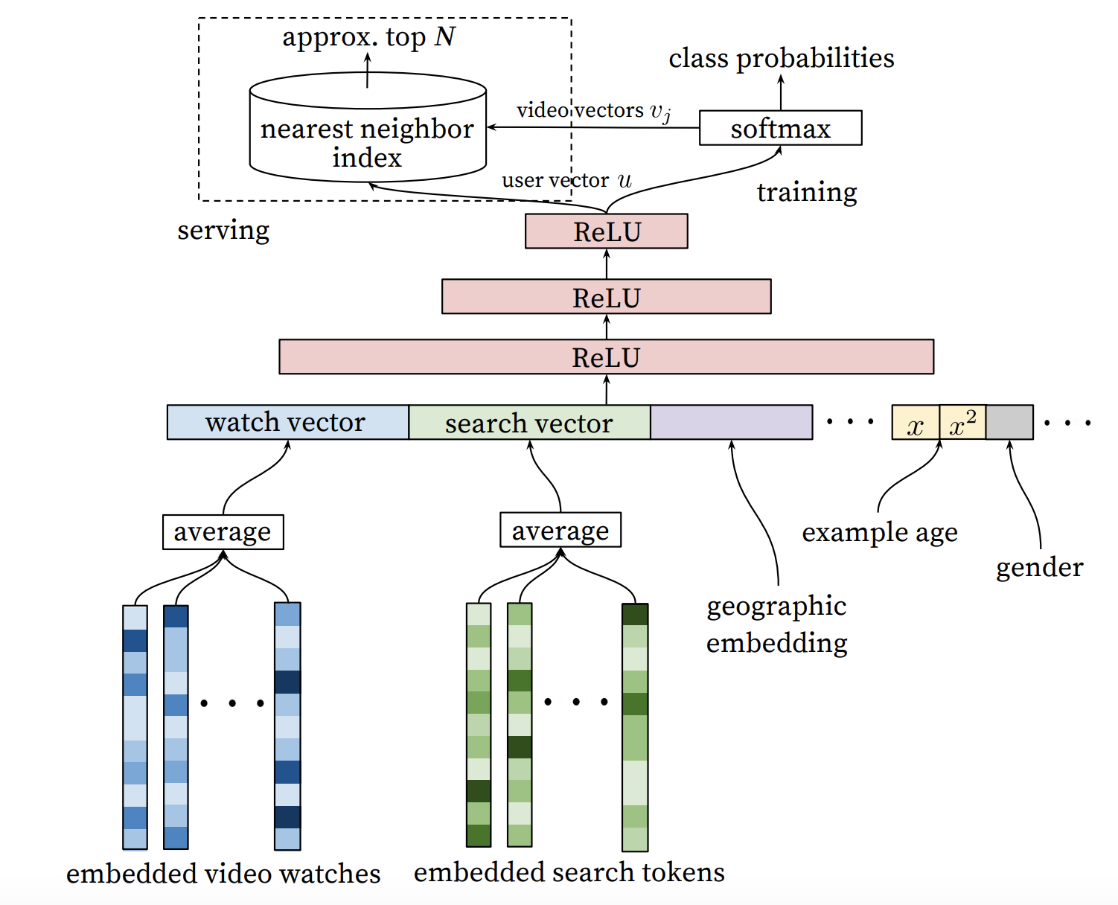
Model 1: Candidate generation
Cross entropy - multiclass classification
(Metric learning?)
Embedding: dimension reduction → sparse to dense vector
Use bad of words or matrix factorization + shallow network?
Feature choices:
Explicit data are not used because of the sparsity, i.e. thumbs up/down, survey etc.
Implicit data are used instead: completing a video (Normalized?)
feed the age of the training example as a feature during training

Slide 25
Models

Slide 26
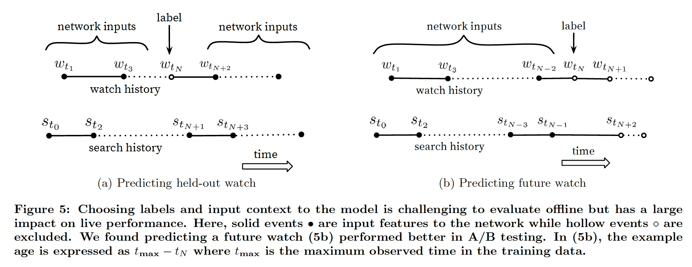
Evaluation metrics
Online A/B testing
Subtle changes in click-through rate
Watch time
Other metrics that measure user engagement?

Slide 27
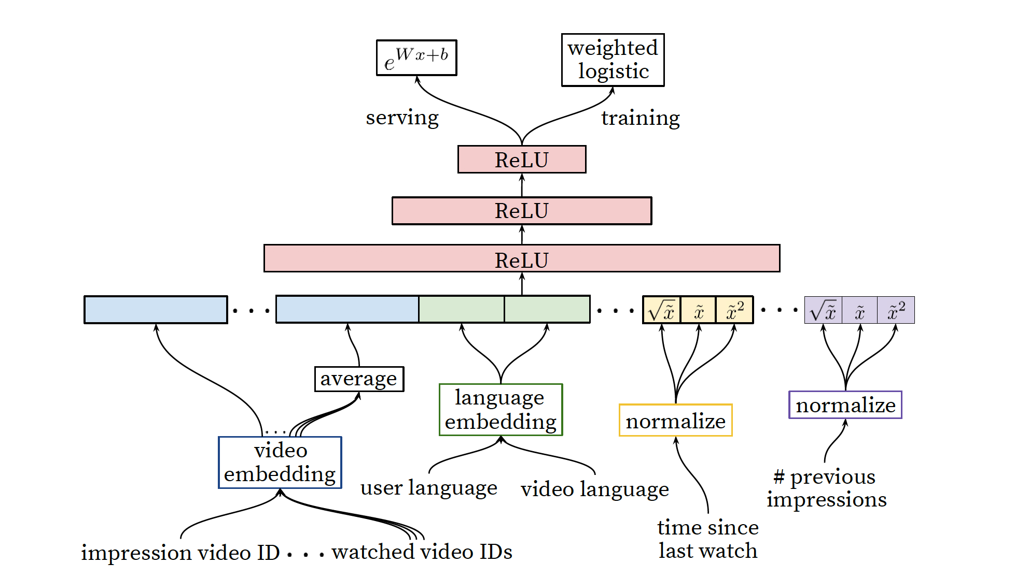
Model 2: Ranking (similar architecture)
256
512
1024

Slide 28
Limitation of youtube recommendation
Old videos are recommended
New videos from subscribes are in a separate page
Can’t handle multi interests

